Slide 1
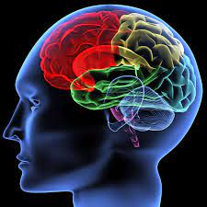
Neural Networks
ENGR 96A: Python and Machine Learning

Slide 2
Introduction
Welcome to neural networks, the other half of what you came to this class to learn!
Machine learning (until now)
Solve relatively simple classification and prediction problems
Important concepts: loss function, gradient descent
Neural networks
A subset of machine learning
Inspired by biological neurons and brain activity
Good for solving more “complex” problems with more inputs

Slide 3

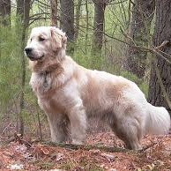
Introduction
These are both dogs!
Inspired by the human brain
Neurons
Action potential
You can probably come up with many of the previous machine learning models yourself without doing all the work and get a high rate of success
Used in more “complicated” problems:
Image classification
Recommendation systems
Signature verification
Analyzing medical data

Slide 4
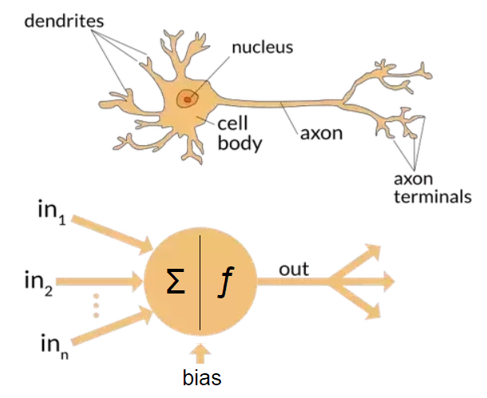
Neurons
Biological neuron receives signal (neurotransmitters) from previous neurons and if enough signal is passed it fires
Action potential: all or nothing response
Will be very important for the development of neural networks
Artificial neuron sums weighted inputs and adds a bias, then activates depending on result

Slide 5
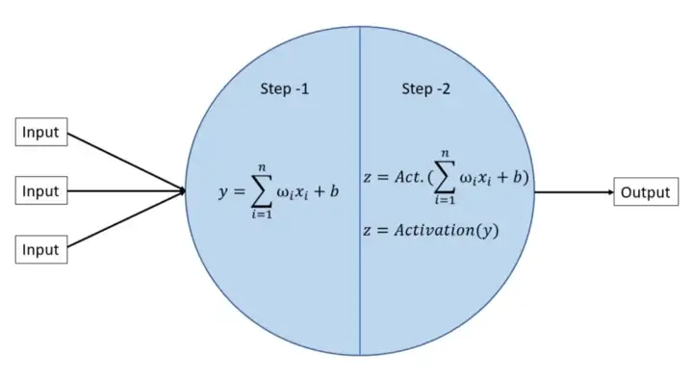
Neuron Calculation

Slide 6
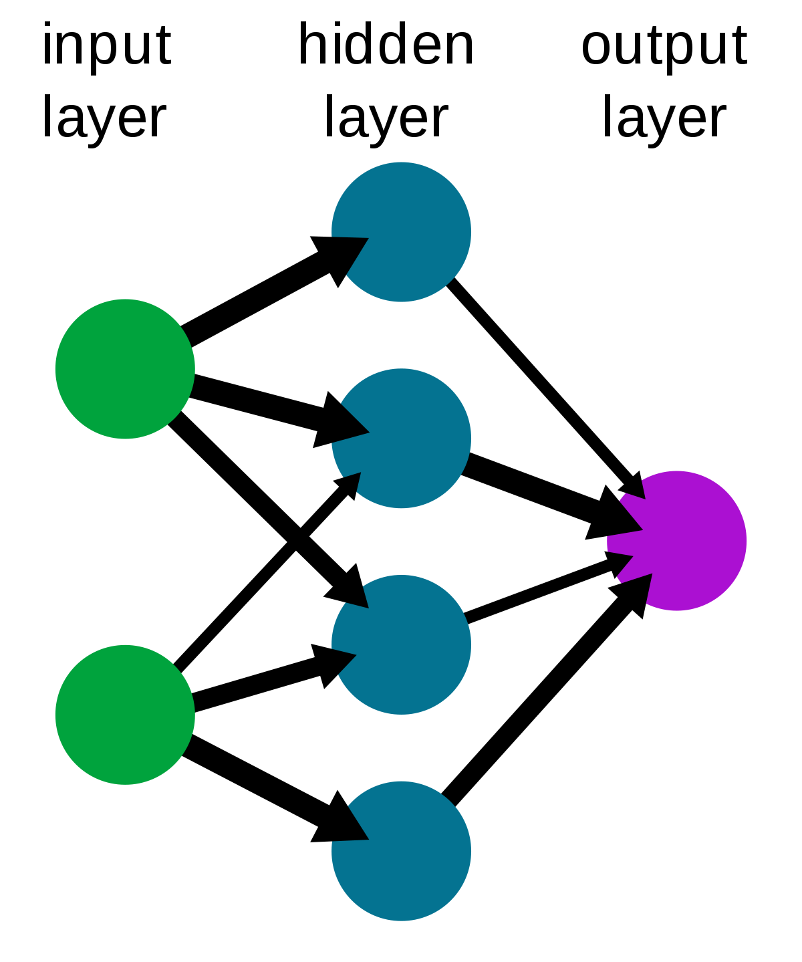
Combining Neurons
Input layer includes all inputs
Sometimes preprocessed, often flattened
Hidden layers receive inputs from all input layers multiplied by some weight with a bias added
Output layer receives inputs from all hidden layers with some weight
All neurons receive input from every previous neuron
Called “Fully connected net”

Slide 7
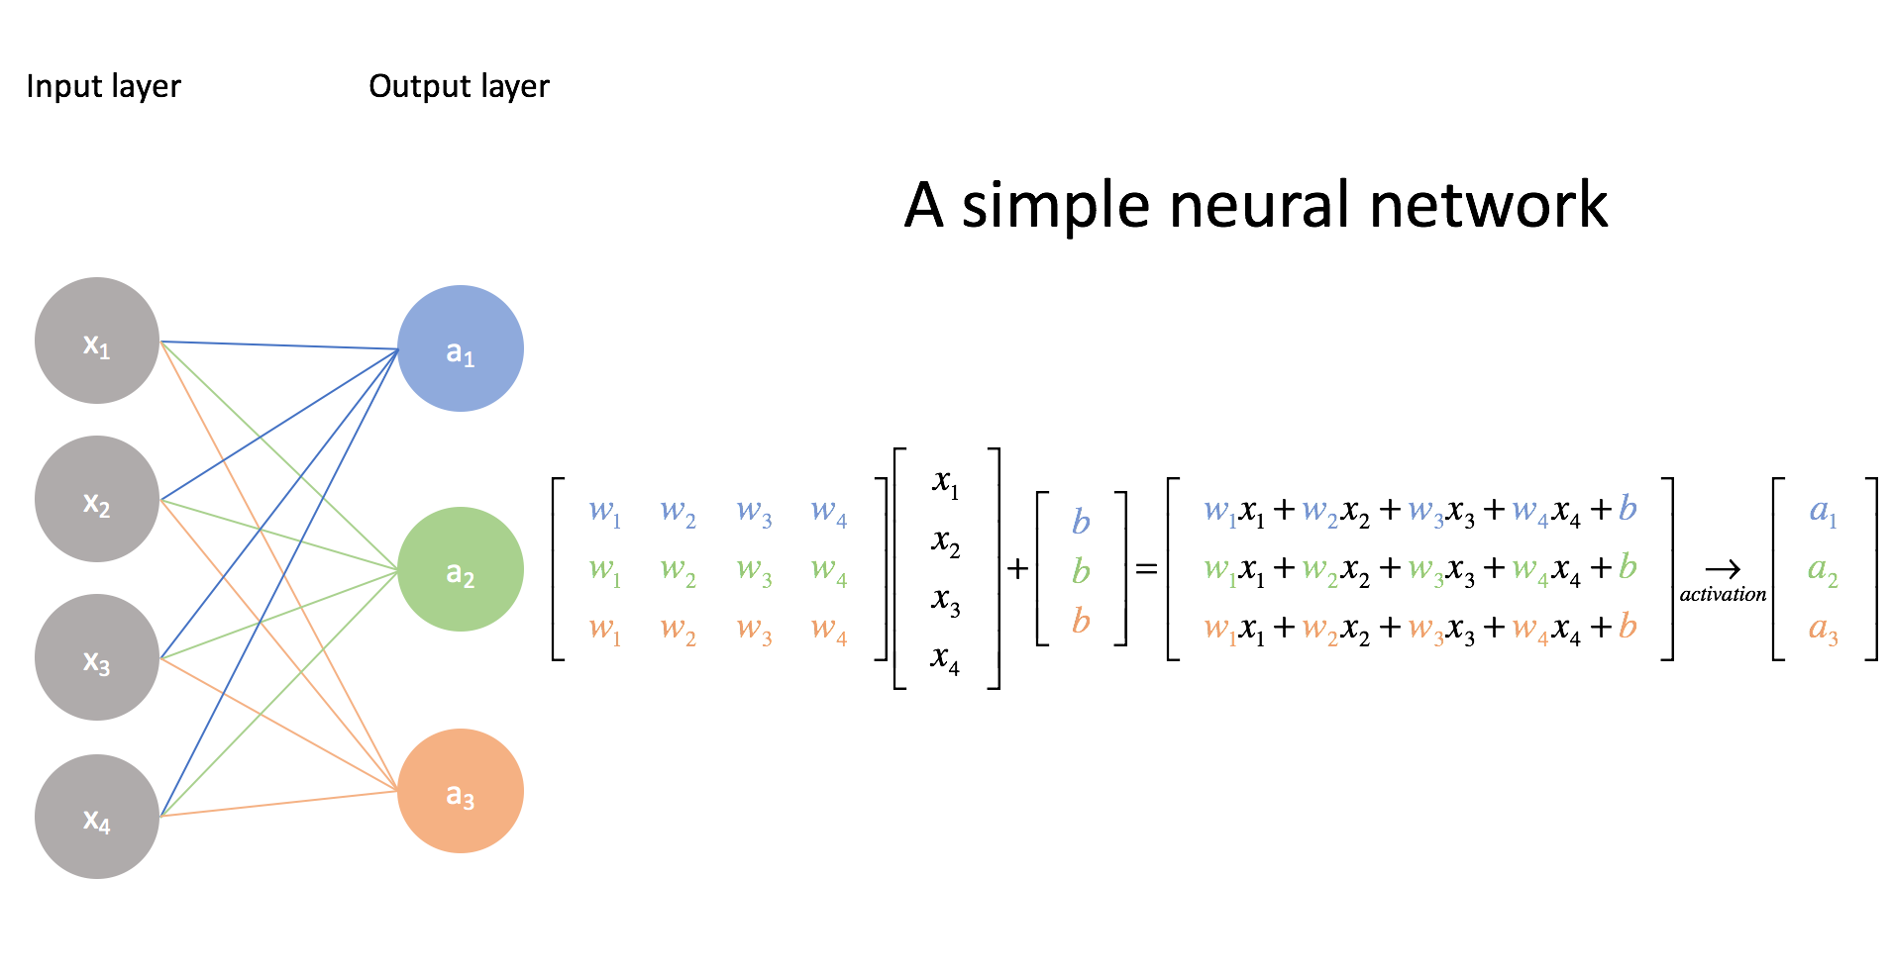
Fully Connected (Affine) Layers
This may be a lot of calculations but we have a tool to store these weights very efficiently
The matrix!

Slide 8
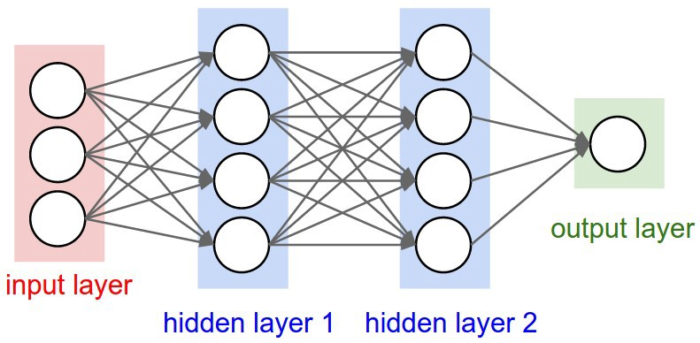
Matrices
Matrices can be used to hold the weights between different layers
Since each neuron is ‘fully connected’ it has a weight to each neuron in the next layer
Let’s say layer 1 has 2 neurons and layer 2 has 4 neurons, how many weights do we have total?
Each neuron in layer 1 must connect to 4 neurons in layer 2
Imagine we make a table describing all of the weights between the input layer and hidden layer 1:
wxy = weight for connection between yth connection in first layer to xth connection in second layer
output \ input | 1 | 2 | 3
1 | w11 | w12 | w13
2 | w21 | w22 | w23
3 | w31 | w32 | w33
4 | w41 | w42 | w43

Slide 9
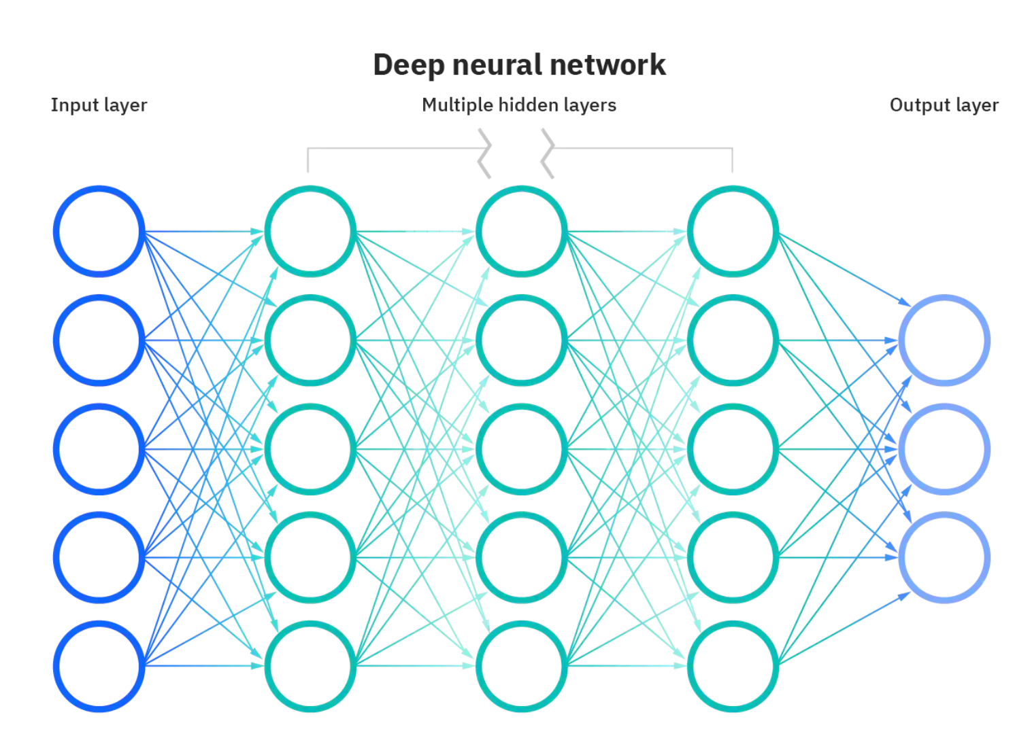
Deep Learning
Chaining many hidden layers together
Allows for more parameters to be trained and often leads to improved models
In this case many matrices will be needed
Be careful! Many layers can make training take a long time

Slide 10
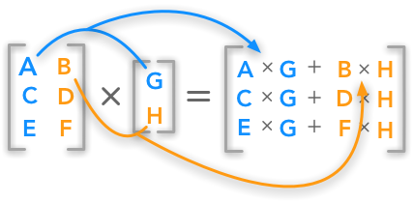
Matrix Multiplication
All elements in the output are influenced by all elements in the input
This is the property we want!
Matrices are typically denoted with a capital letter, vectors a lowercase letter
Matrices have sizes listed Row, Column
If two matrices W1 and W2 are multiplied:
W1*W2
Then W2 must have the same number of Rows as W1 has Columns
A vector must have the same number of elements as the Columns of a matrix multiplying it
Associative, NOT commutative

Slide 11
Associative Property
The associative property of addition: (a + b) + c = a + (b + c)
The associative property of multiplication: (a * b) * c = a * (b * c)
The associative property of matrix multiplication:
Assuming A, B, and C are matrices with the following dimensions:
A: k x n, B: n x m, C: m x q
(A * B) * C = A * (B * C)
In both cases this produces a k x q matrix, in both cases the matrix will be the same

Slide 12
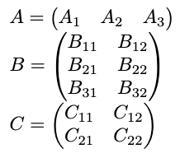
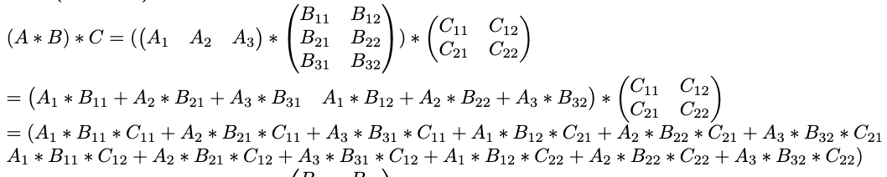
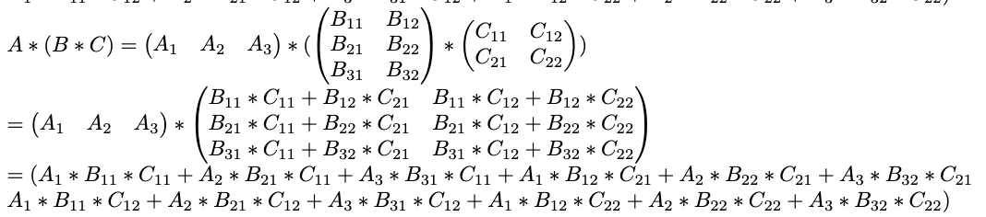
“Proof” of Associative Property

Slide 13
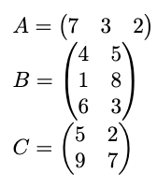
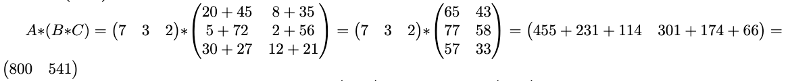
Example of Associative Property

Slide 14
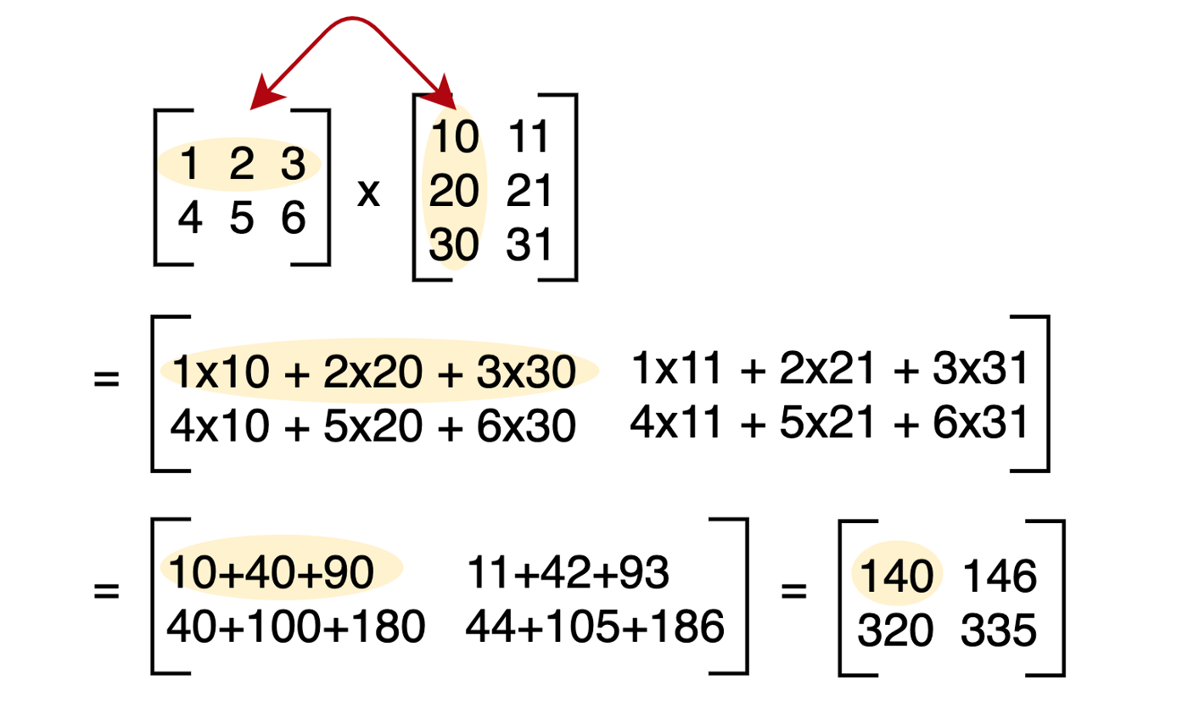
Associative Property
Some of you may have noticed an annoying result of the associative property
In a deep network all the matrices can be multiplied together!
This reduces their usefulness in storing information significantly
For example, if a 2x100 and a 100x2 matrix are used in your neural network, multiplying them together results in a 2x2 matrix!
You are storing 400 values and only getting 4 values worth of information!
Can anyone think of a (biologically inspired) fix to this?

Slide 15
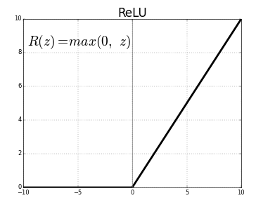
Activation Function
Add a non-linearity in the form of an action function between each layer!
This action function is like the action potential in neurons
This is where a lot of the power in neural networks lie
Typical use in this class: ReLU
Rectified linear activation unit
Wow this must be really hard, right?

Slide 16
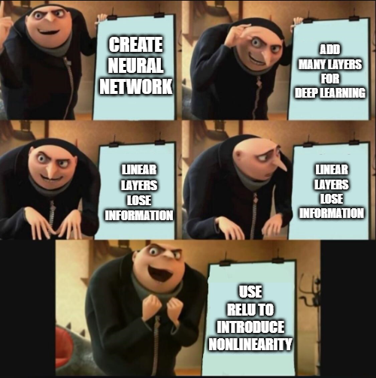
Structure of a Neural Network
Choose n hidden states:
Hidden_1 = ReLU(W0 * input + b0)
Hidden_2 = ReLU(W1 * hidden_1 + b1)
Hidden_n = ReLU(Wn-1 * hidden_n-1 + bn-1)
Output = Wn * hidden_n + bn
Define some loss function
E.g. Mean Squared Error
Train via backpropagation:
Training parameters are all parameters in every W and b
Good news: some libraries make this very easy!

